Slide 1
DATS 6103 – Individual Project 1 – Akshay Kamath
World Military Spending Analysis

Slide 2
Data Sources
SIPRI (Stockholm International Peace Research Institute)
Year-on-Year Military Expenditure (Current USD)
World Bank
Country-wise GDP
GDP Per Capita

Slide 3
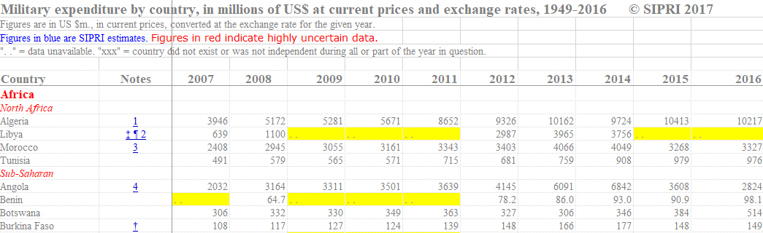
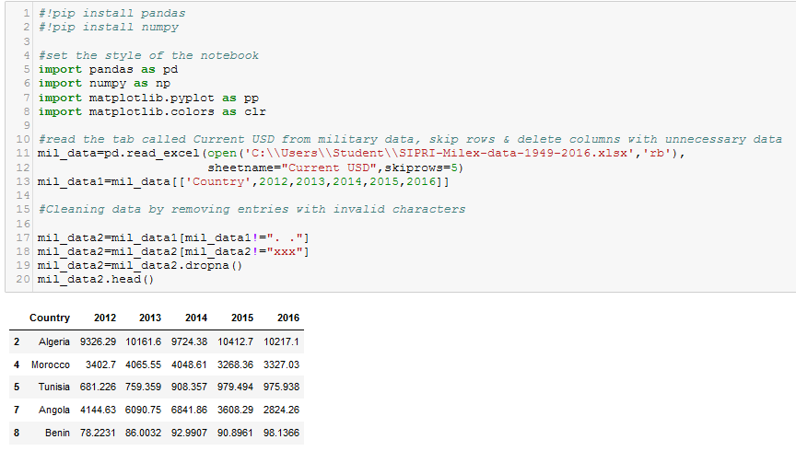

Slide 4
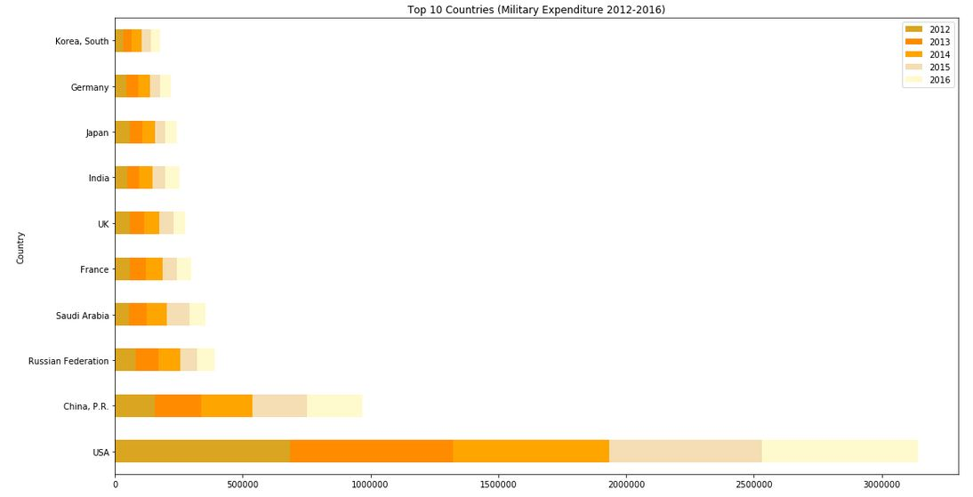
Top 10 countries that spent the most on military (2012-2016)

Slide 5
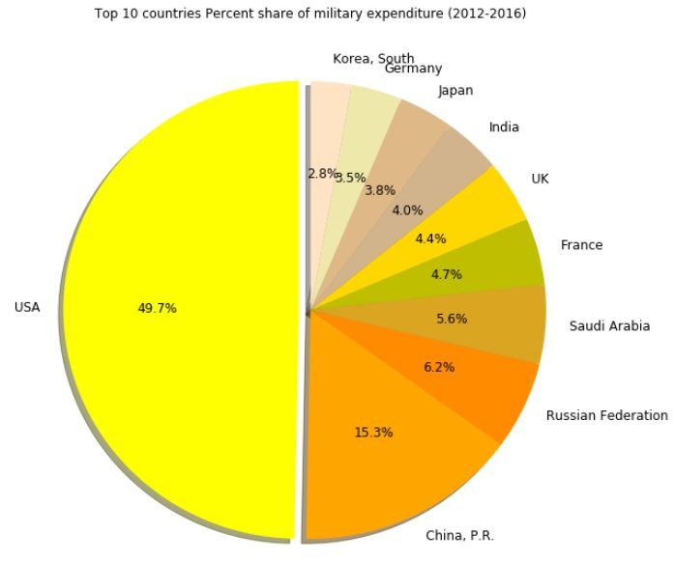
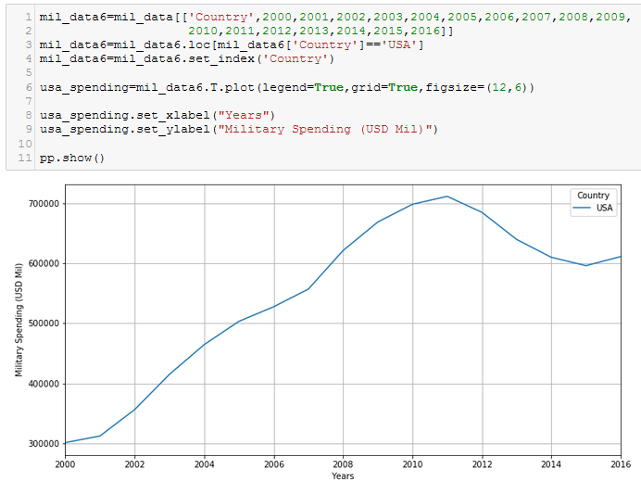
Top 10 countries percent share of military expenditure
71%

Slide 6
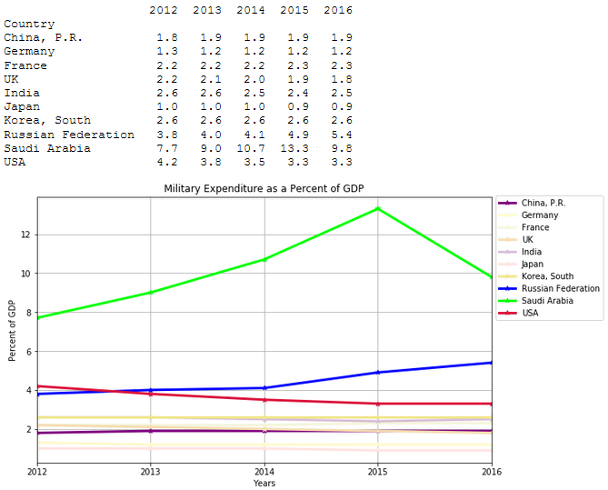
Top 10 countries with military expenditure as a percent of gdp

Slide 7
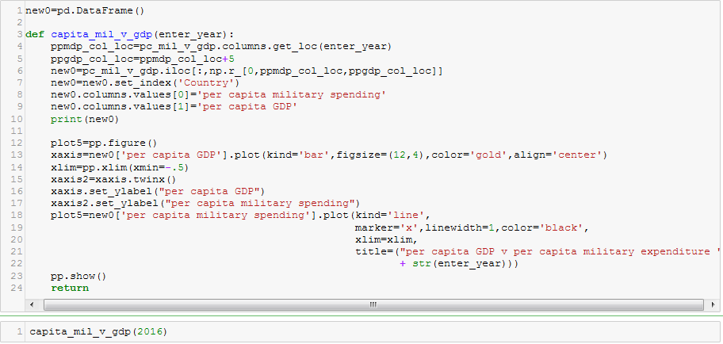
Compare per capita gdp & per capita military expenditure (Top 10 countries)

Slide 8
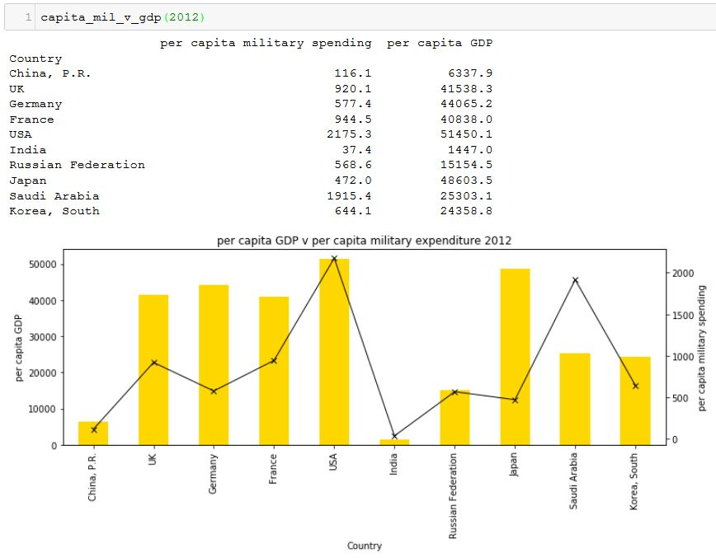
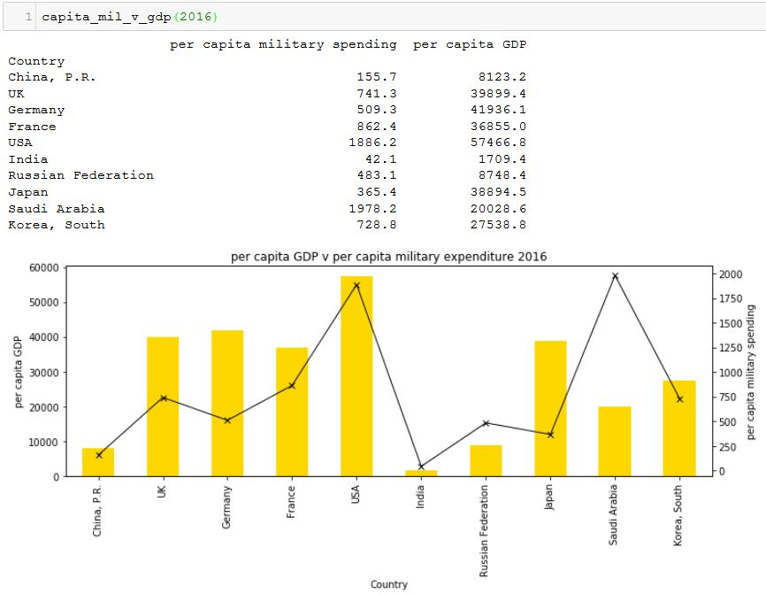
Countries’ per capita military expenditure against per capita gdp

Slide 9
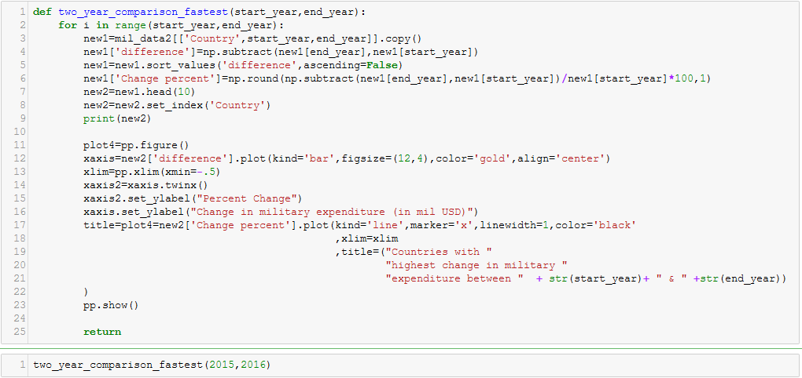
Compare fastest growing countries (on fixed value)

Slide 10
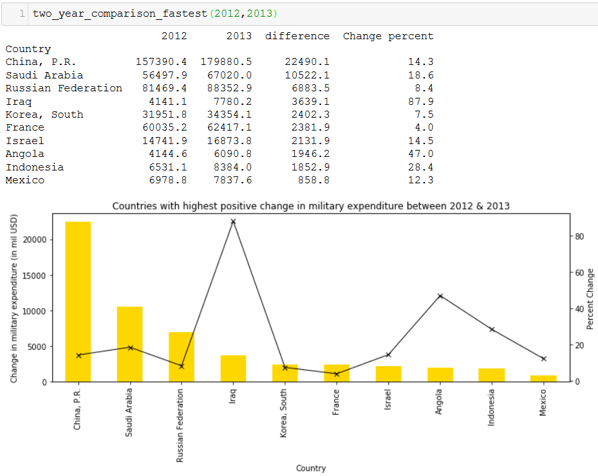
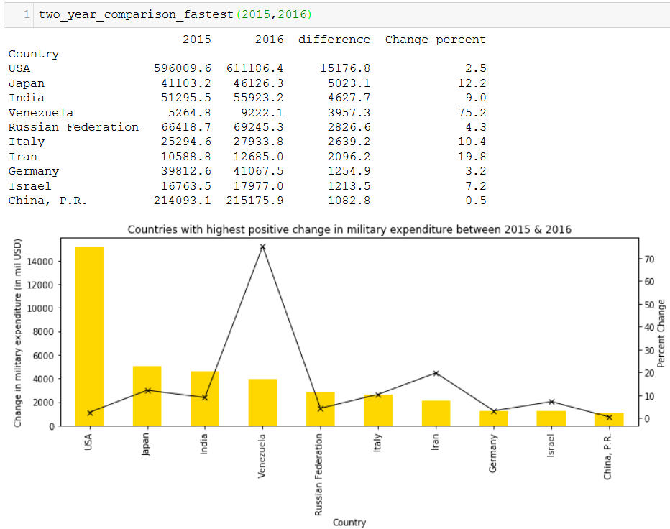
Fastest growing countries (in terms of military expenditure)
*
*
*Iraq’s 2012-13 & Venezuela’s 2015-16 military expenditure figures have been tagged as highly uncertain data by SIPRI

Slide 11
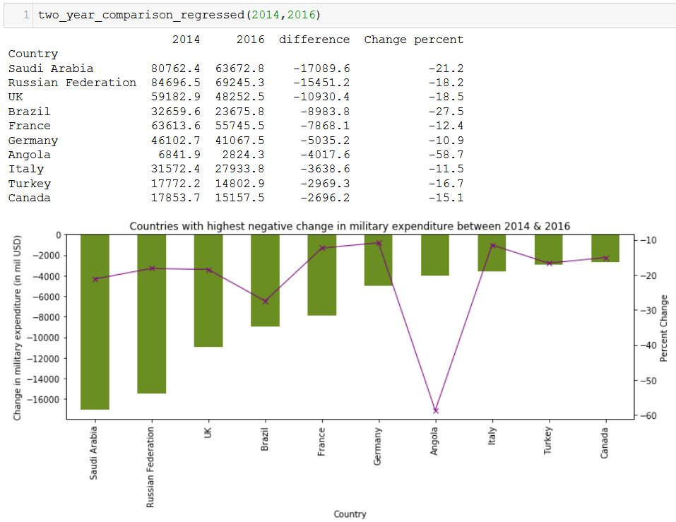
Countries with most cuts in military spending

Slide 12
References
Obama orders troops pull out from Afghanistan (2011)
US defense expenditure post 9/11 (2013)
Angolan military budget expansion (2013)
Angolan military spending drops due to commodity price fall (2016)
Iran doubles down on military budget (2016)
Russia cuts its defense budget (2017)
China to raise military spending but less than recent years (2017)
Military expenditure correlated with oil prices (2017)

